Slide 1
HR Analytics Assignment
Created by – Nikhil Dhasmana
Date- 10-11-2025

Slide 2
Overview
Objective
Data Analysis Points

Slide 3
Objective
To analyse workforce patterns and build a Power BI dashboard that transforms HR data into actionable insights for better decision-making.

Slide 4
Data Analysis Points
Attrition Analysis
Performance Rating Distribution
Promotion Impact Analysis
Exit Reason Breakdown
Manager-wise Exit Feedback
Country-wise Workforce Comparison
Tenure vs Performance
Joining & Exit Patterns
Employee Status Distribution
Organisational Culture Sentiment

Slide 5
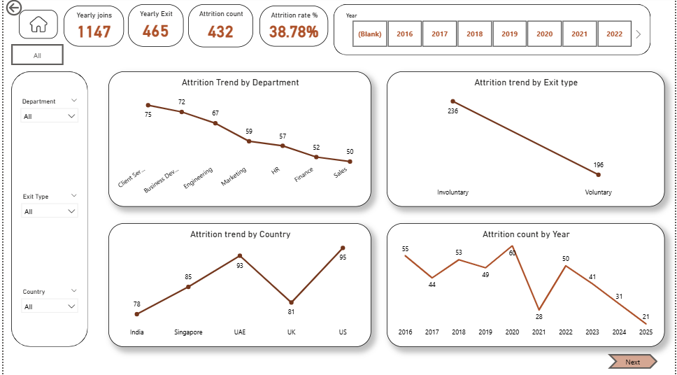
Attrition Analysis
Insights
Attrition Trend by Department
Sales and Engineering show consistently high attrition,
while Finance and HR remain stable with lower exits.
Attrition Trend by Exit Type
▪ Involuntary exits were higher earlier, but recent years show more voluntary resignations,
indicating rising employee dissatisfaction.
Attrition Trend by Country
▪ Attrition is highest in the UK and US,
suggesting stronger retention challenges there compared to India and Singapore.
Attrition Count by Year
▪ Attrition peaked around 2020 and 2022 but has been steadily declining since,
showing gradual improvement in retention efforts.
Overall Insight
▪ The overall attrition rate dropped from 38% to 25%, reflecting positive progress in employee retention.
Suggestions
▪ Focus on improving retention in Sales and Engineering departments through better career growth and work-life balance.
▪ Conduct exit interviews to understand why voluntary resignations are increasing.
▪ Review compensation and management practices in the UK and US to address higher attrition there.
▪ Keep tracking attrition trends yearly to ensure the declining trend continues.

Slide 6
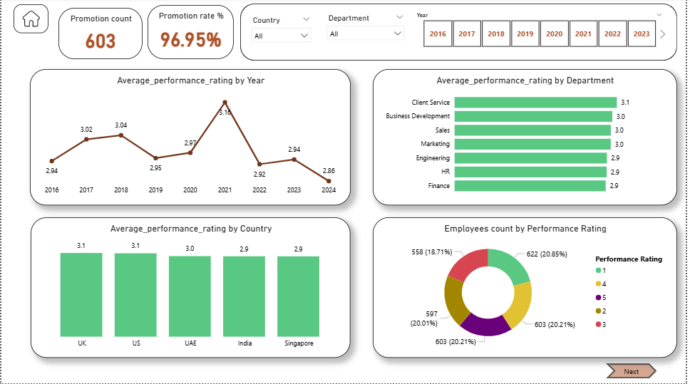
Performance rating distribution
Insights
1. Average Performance Rating by Year
▪ Performance ratings peaked in 2021 (3.16), After 2021,
ratings gradually declined, suggesting possible burnout or reduced motivation post-pandemic.
2. Average Performance Rating by Department
Client Service (3.1) has the highest average rating, showing strong and consistent performance.
Finance and HR (2.9) have slightly lower ratings,
indicating scope for performance improvement or training focus.
3. Average Performance Rating by Country
▪ Ratings are fairly consistent across all countries, with the UK and US (3.1) slightly ahead of others.
India and Singapore (2.9) show marginally lower averages.
4. Employees Count by Performance Rating
▪ The distribution is quite balanced across all rating levels▪ About 20% of employees fall in each rating category,
showing a stable and fair evaluation process.
Suggestions
▪ Maintain post-2021 performance levels by setting clear goals and regular feedback sessions.
▪ Provide extra training for Finance and HR teams to lift their average ratings.
▪ Keep the current evaluation system consistent across all countries.
▪ Review the promotion process to ensure it stays performance-based and fair.
▪ Learn from Client Service’s high performance and apply similar practices elsewhere.
▪ Conduct rating calibration meetings to keep evaluations unbiased.
▪ Support employees with lower ratings through mentorship and skill development programs.

Slide 7
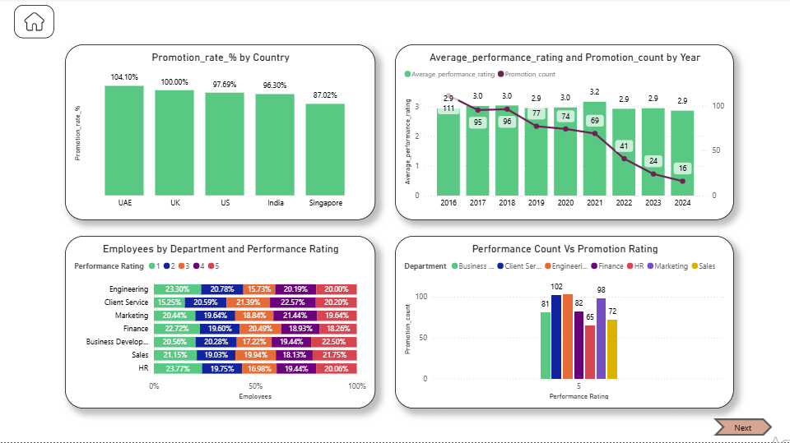
Promotion impact analysis
Insights
1. Promotion Rate % by Country
▪ The UAE (104%) and UK (100%) have the highest promotion rates,while Singapore (87%) is the lowest.
▪ Overall, promotion rates remain strong across all countries,showing good global recognition practices.
2. Average Performance Rating and Promotion Count by Year
Promotions were highest between 2016–2020, aligning with better performance ratings.
After 2021, both promotion count and performance ratings dropped,
suggesting reduced performance-linked promotions.
3. Employees by Department and Performance Rating
▪ Most departments have a balanced rating mix,
but Engineering and HR have slightly higher shares of top performers.
▪ Finance shows more mid-level ratings, indicating room for skill enhancement or motivation improvement.
4. Performance Count vs Promotion Rating
▪ Departments like Client Service and Engineering have the most promotions among top-rated employees.
▪ This shows that promotions are mainly performance-driven, especially for employees rated 5.
Suggestions
▪ Review the post-2021 promotion criteria to ensure high performers continue to be rewarded fairly.
▪ Focus on improving promotion opportunities in Singapore, where the rate is lowest.
▪ Provide development programs for mid-rated employees in Finance and Marketing to boost readiness for promotion.
▪ Maintain the strong performance-linked promotion system seen in Client Service and Engineering.
▪ Conduct regular performance calibration sessions to keep ratings and promotions aligned across all departments.
▪ Encourage manager-led recognition and feedback to sustain motivation after the drop in promotions.

Slide 8
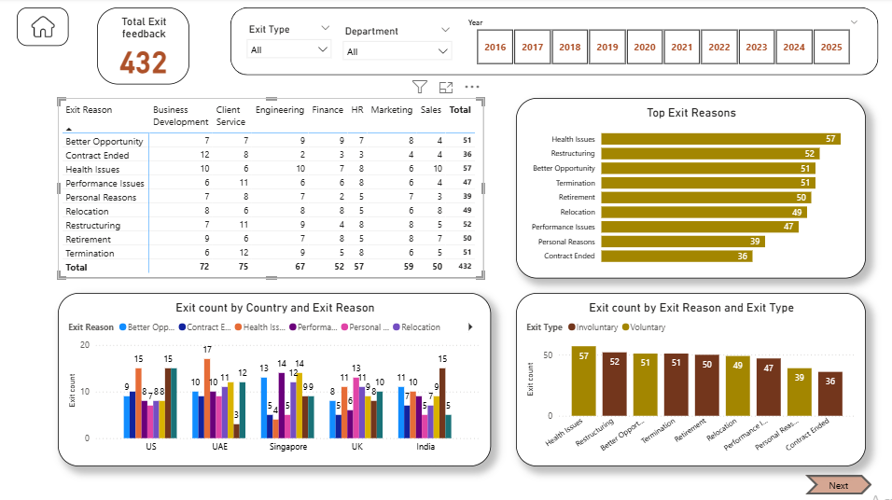
Exit Reason breakdown
Insights
1. Top Exit Reasons (Bar Chart)
▪ Health Issues (57) and Restructuring (52) are the leading causes of exits.
▪ Better Opportunity and Termination follow closely, both at 51 exits,
showing a mix of voluntary and company-driven attrition.
▪ Most exits are due to personal or organizational factors, not performance
2. Exit Count by Country and Exit Reason (Clustered Chart)
▪ Exit reasons vary by country -UAE and US show higher exits for Better Opportunity and Restructuring.
▪ India and UK have more balanced exit reasons across categories, suggesting consistent HR policies globally.
▪ Singapore shows moderate exits, mainly linked to Health Issues and Relocation.
3. Exit Count by Exit Reason and Exit Type (Column Chart)
▪ Health Issues and Restructuring are primarily involuntary exits, indicating company or personal health-related separations.
▪ Better Opportunity, Relocation, and Personal Reasons are mainly voluntary exits, reflecting external pull factors.
▪ The mix shows that about half of exits are within company control (involuntary) and half are employee-driven (voluntary).
4. Exit Reason by Department (Table View)
▪ Client Service (75) and Business Development (72) departments record the highest total exits.
▪ Finance and HR have the lowest exit counts, indicating better retention.
▪ Common reasons across most departments are Health Issues, Restructuring, and Better Opportunities.
Overall Insight
▪ A total of 432 exits were recorded , mainly driven by health-related issues, restructuring, and external job opportunities.
▪ Both voluntary and involuntary exits contribute significantly, indicating the need for balanced retention and wellbeing initiatives.
Key Suggestions
▪ Strengthen employee health and wellness programs since health issues are the top exit reason.
▪ Improve restructuring and termination communication to reduce involuntary exits.
▪ Focus on career growth and internal promotion paths to prevent employees from leaving for better opportunities.
▪ Prioritise retention in Client Service and Business Development departments where exits are highest.
▪ Conduct stay interviews to understand and address reasons for voluntary resignations early.
▪ Use exit feedback data to identify recurring problems and act before they escalate.

Slide 9
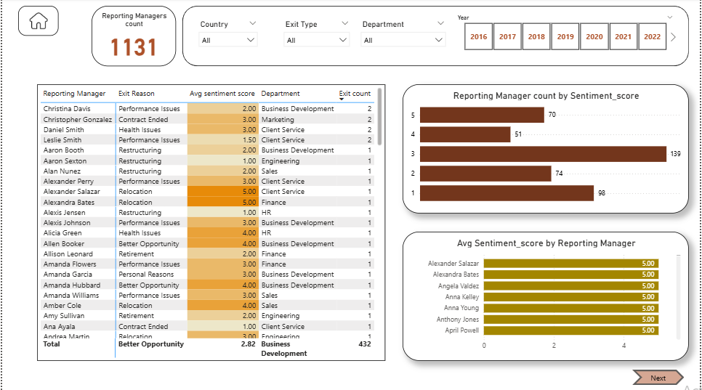
Manager wise exit feedback
1. Reporting Manager Count by Sentiment Score
▪ Most managers have average sentiment scores between 2–4, showing moderate employee satisfaction.
▪ A small group of managers achieved a score of 5, indicating high employee trust and positive feedback.
▪ Few managers scored 1–2, which highlights potential management or communication issues.
2. Average Sentiment Score by Reporting Manager
▪ Managers like Alexandra Bates and Alexander Salazar consistently received the highest sentiment scores (5.0).
▪ Several managers recorded low sentiment scores (1.0–2.0), which signals dissatisfaction among their teams.
▪ These score differences indicate uneven leadership quality across departments.
3. Manager vs Exit Reason Table
▪ Many exits due to performance issues, restructuring,
or better opportunities are linked to managers with lower sentiment scores.
▪ Business Development shows higher exits under managers with low sentiment, suggesting leadership or workload challenges.
▪ Managers with better sentiment scores (4–5) often have exits due to relocation or retirement, implying satisfied employees leaving for external reasons.
Overall Insights
▪ Average sentiment score across managers is around 2.8, showing room for improvement in people management.
▪ Business Development appears to have the most exits and lower manager sentiment overall.
▪ Positive manager feedback correlates strongly with fewer voluntary exits.
Key Suggestions
▪ Provide leadership and communication training for managers with low sentiment scores.
▪ Recognise and reward high-rated managers to reinforce positive management practices.
▪ Focus on improving manager-employee relationships in the Business Development department where sentiment is lowest.
▪ Conduct regular employee feedback surveys to track changes in sentiment and detect issues early.
▪ Pair low-performing managers with mentors or HR partners for coaching and improvement.

Slide 10
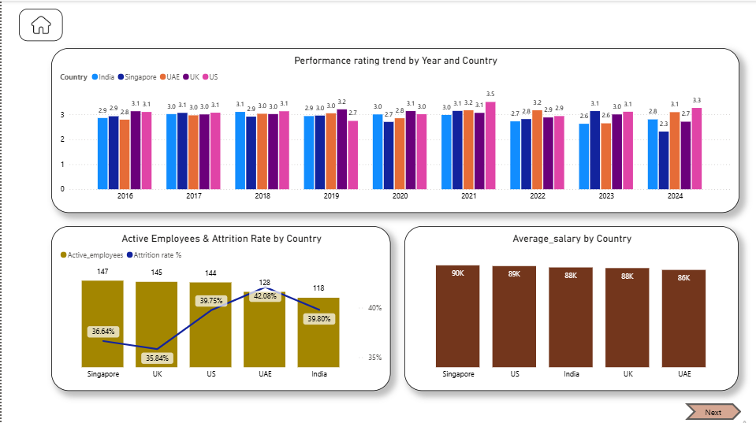
Country Wise Workforce Comparison
Insights
1. Performance Rating Trend by Year and Country
▪ Performance ratings remain consistent across all countries (around 3.0).
▪ UK and US show slightly higher ratings, while India and Singapore remain stable but marginally lower.
▪ A small dip in 2023 indicates reduced performance consistency post-2021.
2. Active Employees & Attrition Rate by Country
▪ UAE (42%) and US (39.7%) have the highest attrition rates.
▪ UK (35.8%) shows the lowest attrition, suggesting stronger retention.
▪ Employee count is highest in Singapore, yet its attrition rate remains moderate.
3. Average Salary by Country
▪ Salaries are closely aligned, ranging between 86K–90K.
▪ Singapore leads with the highest average salary (90K), while UAE has the lowest (86K).
▪ Despite similar pay levels, attrition varies, indicating other non-monetary factors influencing exits.
Key Suggestions
▪ Focus on retention strategies in UAE and US, where attrition rates are the highest.
▪ Review workplace environment and management practices in these countries since pay alone isn’t reducing attrition.
▪ Encourage knowledge sharing from UK teams, where retention is best, to replicate their success model.
▪ Introduce career development programs and employee engagement activities in India and Singapore to sustain stable performance.
▪ Regularly review salary and benefits benchmarking to ensure competitiveness across regions.
▪ Monitor post-2021 performance trends closely to identify factors behind slight performance dips.

Slide 11
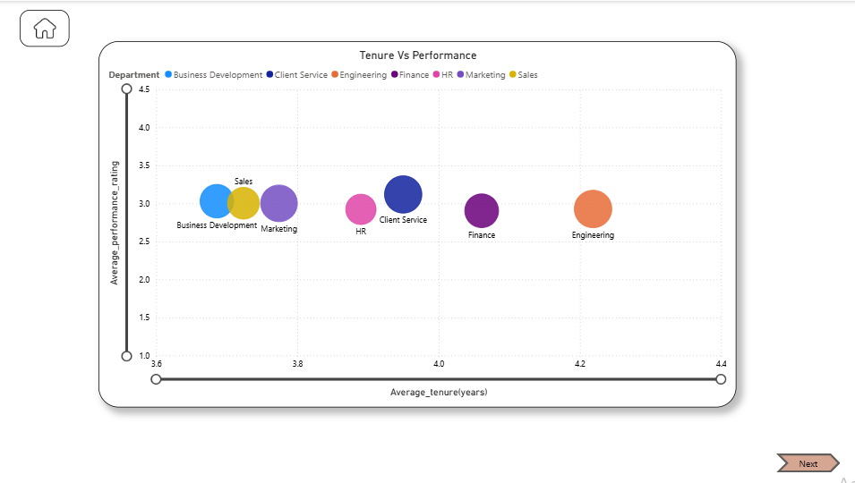
Tenure Vs Performance
Insights
▪ Engineering department has the highest average tenure (4.22 years) and
strong promotion count (103), but performance rating (2.9) is moderate,
indicating long-serving employees with room for upskilling.
▪ Client Service shows a balanced tenure (3.95 years) and
the highest performance rating (3.12) along with good promotion activity (102),
suggesting a healthy retention–performance balance.
▪ Finance and HR have stable tenures (~4 years) but
lower performance ratings (2.9–2.92), hinting at stagnation or lack of motivation over time.
▪ Sales and Marketing have shorter tenures (3.7 years) with average performance (~3.0),
possibly due to high-pressure roles and faster employee turnover.
▪ Business Development has short tenure (3.6 years) and moderate performance (3.03),
showing a need for better retention and performance support.
Key Suggestions
▪ Upskill long-tenured employees in departments like Engineering, Finance, and HR to sustain performance over time.
▪ Strengthen career growth and recognition programs in Sales and Business Development to improve retention.
▪ Use Client Service’s management practices as a model for balancing performance and tenure across teams.
▪ Introduce learning and rotation opportunities for employees with long tenure but stagnant ratings.
▪ Monitor performance vs. tenure trends quarterly to detect early signs of disengagement.

Slide 12
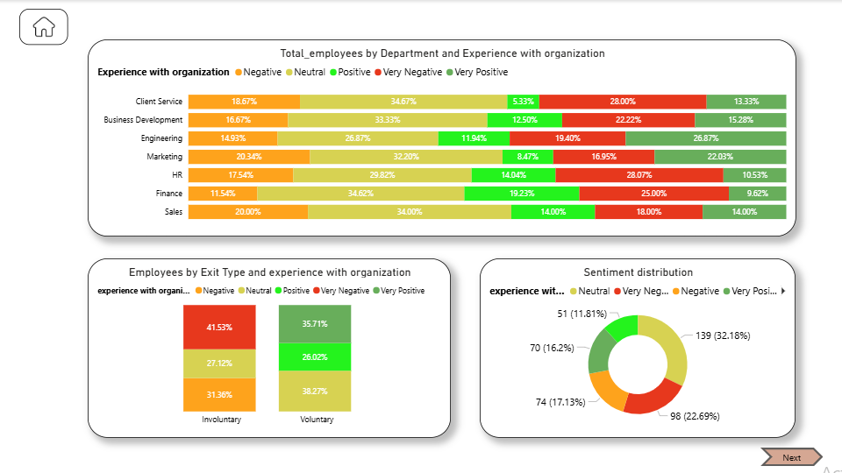
Organizational culture sentiment
Insights
1. Total Employees by Department and Experience with Organization
▪ Finance and Engineering have the highest share of positive and very positive experiences,
indicating strong work satisfaction.
▪ HR and Sales show higher negative and very negative experiences,
suggesting issues in culture, workload, or management.
▪ Client Service and Business Development have a balanced mix,
but both still show around 20–25% negative sentiment.
▪ Overall, most departments have a large neutral to positive sentiment,
but negativity in key functions (Sales, HR) needs attention.
2. Employees by Exit Type and Experience with Organization
▪ Employees leaving voluntarily report more positive experiences (38%), showing they leave for better opportunities rather than dissatisfaction.
▪ Those with involuntary exits show higher negative sentiment (41%), indicating performance or management-related issues during exits.
3. Sentiment Distribution (Overall)
▪ Overall sentiment distribution: 32% neutral, 23% negative, 17% very negative, and only 11% very positive.
▪ Positive sentiment is present but not dominant — this reflects a workplace with moderate satisfaction and improvement scope in engagement and morale.
Key insights
▪ Focus on improving work culture and leadership quality in Sales and HR, where negative sentiment is highest.
▪ Conduct employee engagement and feedback sessions to identify root causes of dissatisfaction.
▪ Use Finance and Engineering departments as benchmarks for positive culture practices.
▪ Provide manager training on handling teams empathetically, especially before involuntary exits.
▪ Implement a recognition and reward program to boost morale and positivity across departments.

Slide 13
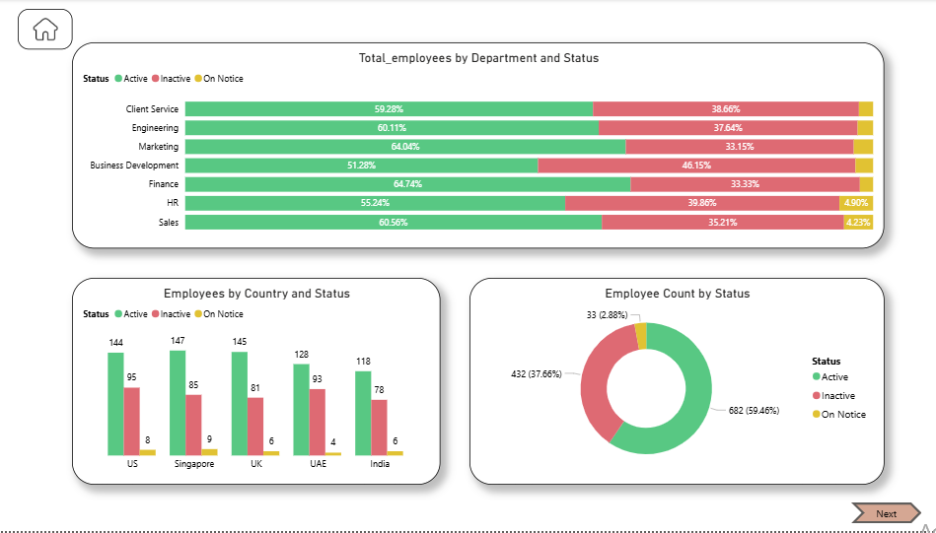
Employees status Distribution
Insights
▪ Overall workforce: 59.46% active, 37.66% inactive, and 2.88% on notice -
showing a healthy majority still retained but with a noticeable inactive proportion.
▪ Finance and Marketing have the highest active ratio (64%),
showing strong workforce stability.
▪ Business Development has the lowest active ratio (51%) and
the highest inactive rate (46%), signalling high turnover or project instability.
▪ HR also shows higher inactive employees (≈40%),
which might affect internal operations and hiring efficiency.
▪ By country, the US and Singapore have the largest employee bases,
while India and UAE maintain relatively high active-to-inactive balance.
Suggestions
▪ Focus retention efforts on Business Development and HR, where inactivity and turnover are high.
▪ Conduct exit and engagement analysis to identify reasons behind high attrition in specific departments.
▪ Maintain best practices from Finance and Marketing, where employee stability is strongest.
▪ Strengthen career growth and incentive programs to convert “on notice” employees into long-term retainers.
▪ Monitor active–inactive trends quarterly to detect emerging workforce risks early.

Slide 14
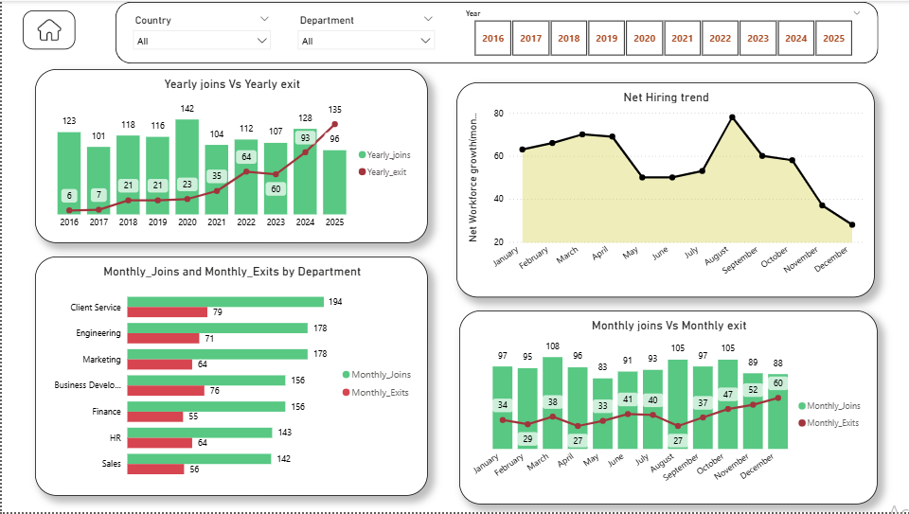
Joining Vs Exiting pattern
Insights
▪ From 2016–2021, hiring consistently exceeded exits, showing strong workforce growth and stability.
▪ Starting 2022, exits began rising steadily,
and by 2025,exits (135) surpassed joins (96), indicating a clear retention crisis.
▪ Q4 (Nov–Dec) repeatedly shows the highest exits every year,
revealing a recurring year-end attrition pattern.
▪ Client Service, HR, and Business Development departments face the highest turnover,
suggesting cultural or workload-related issues.
▪ Finance and HR, once stable, showed a sharp rise in exits post-2023,
pointing to internal dissatisfaction even in support roles.
▪ Net hiring trend turned negative in 2025, marking a shift from expansion to contraction phase.
▪ The overall trend highlights a post-pandemic decline in retention and engagement,
requiring urgent attention.
suggestions
▪ Prioritise retention — focus on keeping existing talent before scaling new hiring.
▪ Conduct root cause analysis for rising attrition in HR, Finance, and Client Service departments.
▪ Launch employee engagement and recognition programs before Q4 to reduce year-end exits.
▪ Strengthen career growth, training, and internal mobility to retain mid-level employees.
▪ Use predictive analytics in Power BI to identify and address early attrition signals.
▪ Balance hiring throughout the year instead of clustered recruitment in mid-year months.
▪ Improve managerial feedback, workload balance, and communication to rebuild employee trust and morale.

Slide 15
Thankyou

